Slide 1
Computer vision for industrial inspection
NVIDIA DLI

Slide 2
Workshop summary
Computer Vision for Industrial Inspection
Full-day, 8-hour workshop consisting of three hands-on labs
End-to-end deep learning pipeline across data pre-processing, model training, and deployment, based on a real production dataset
The project was hand-picked by NVIDIA’s internal customer (manufacturing operations team) and is the creation of a six-month collaboration across multiple teams at NVIDIA globally
Learn how to reduce high false positive rate of the capacitor components of printed circuit board assemblies (PCBAs) obtained from production automatic optical inspection (AOI) machines. By applying deep learning, false positives can be reduced to zero (from 10% - 70%) with similar escape rates
The tools we will utilize include NVIDIA DALI, NVIDIA TAO Toolkit, NVIDIA TensorRT, and NVIDIA Triton Inference Server

Slide 3
What does this workshop cover
Overview of computer vision applications for various industrial inspection use cases
Data collection, curation, augmentation, defining performance metrics, training, inferencing, and iterating the whole processing pipeline to improve performance
Data curation covers processing raw dataset into DataFrames, exploratory data analysis, balancing heavily imbalanced dataset, and data augmentation
Data augmentation provides both offline and online approaches using various augmentation techniques
Transfer learning methodology – starts with pre-trained network (ResNet-50) and fine-tune the model on a new custom dataset
GPU-accelerated TensorRT inferencing for fast end-to-end prototyping

Slide 4
Workshop Outline
Lab 1 | Automated Optical Inspection and Data Exploration Discuss automatic optical inspection, PCBA process, and current challenges of AOI machines on high false positives Perform EDA on real dataset from GPU production line Scope into short-term DL automation problem
Lab 2 | Model Training with Transfer Learning Apply transfer learning with ResNet-50 architecture Fine-tune the model and set up evaluation metrics Apply augmentation technique to solve heavily imbalanced dataset Examine a confusion matrix and fine-tune results based on domain-expert tunable thresholding
Lab 3 | Model Deployment for Inference Compile trained ResNet-50 model as TensorRT engine Deploy TRT engine to Triton Inference Server Experiment various inference configurations to optimize performance
Assessment

Slide 5
AGENDA
Lab 1 - Automatic Optical Inspection and Data Exploration Discuss automatic optical inspection, PCBA process, and current challenges of AOI machines on high false positives Perform EDA on real dataset from GPU production line Scope into short-term DL automation problem
Lab 2 – Model Training with Transfer Learning
Lab 3 – Model Deployment for Inference
Assessment

Slide 6
Computer Vision
Brief Primer on Computer Vision (Source)
Has been in some form of its present existence for decades
Enables devices to perceive, analyze, and interpret data in digital images and video. It’s also referred to as:
Vision AI
Traditional image processing in specific non-AI instances
Machine vision in manufacturing and industrial use cases
Computer vision tasks include:
These tasks benefit from using AI-based computer vision algorithms because of the accuracy and robustness that can be achieved. In many cases, AI-based computer vision algorithms can outperform traditional algorithms in terms of these two performance metrics
Detection | Classification | Segmentation | Image Synthesis
Locate, and sometimes track, where an object exists in an image | Determine what object exists within the visual data | Classify pixels belonging to a certain category | Create synthetic data by morphing existing digital images to contain desired content

Slide 7
Classification & segmentation defects
We deal with defect classification problems using deep learning models to reduce false positives of capacitors in PCBAs obtained from a real production factory
We used pre-trained ResNet-50 as a base-classifier, and then transfer-learned and fine-tuned to PCBA production dataset
For defects segmentation, we recommend the NVIDIA whitepaper on Automatic Defect Inspection Using the NVIDIA End-to-End Deep Learning Platform. This whitepaper covers how to use U-net and public DAGM dataset (with NVIDIA GPU T4 and TRT5). It shows 23.5x performance boost using T4 and TRT5, compared to CPU-TF

Slide 8
Classification Objective
Achieve High Accuracy and Minimize Error
For classification tasks – it’s often important to minimize errors:
False Positive – when predicted as defective when it’s not (False Positive)
False Negative – when predicted as not defective while it is (Escape)
 |  | Predicted
 |  | Positive | Negative
Actual | Positive | True Positive | False Negative
 | Negative | False Positive | True Negative

Slide 9


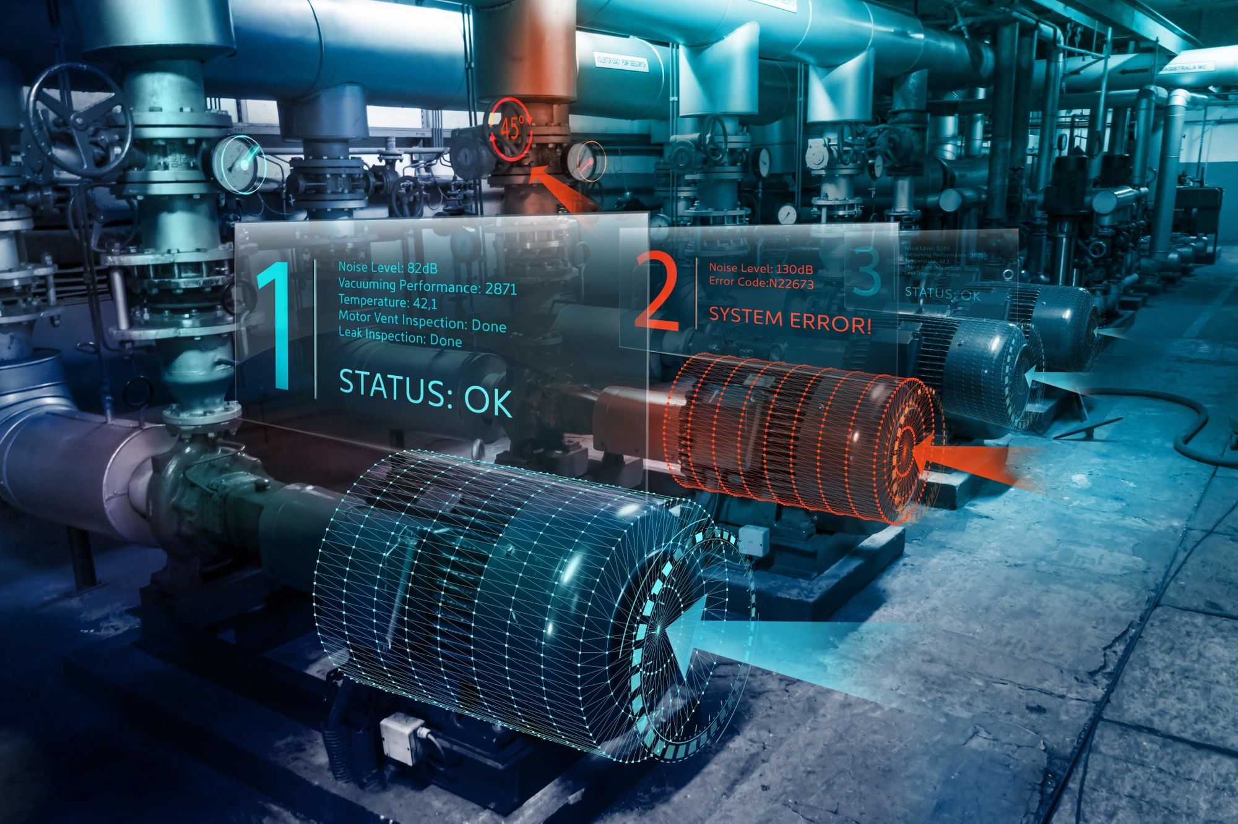


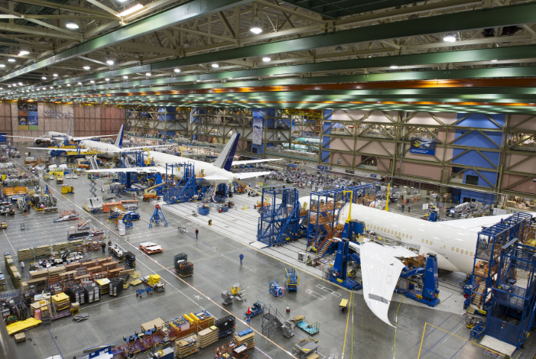
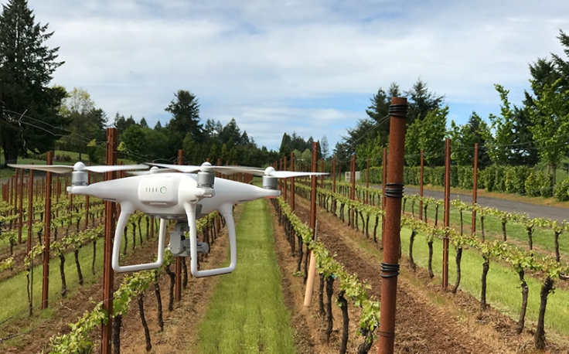

Industrial Inspection Use cases
Inspection is a Critical Function Across Industries
Construction
Auto
Infrastructure
Agriculture
Energy
Aerospace
Drone Inspection
Manufacturing

Slide 10
Automation in Industrial Inspection
Innovations in Inspection Processes, Equipment, and Infrastructure to Ensure Quality and Safety
Requires special hardware and software to achieve efficiency
Optical and visual (unaided) inspection are widely used
Weaknesses in current solutions:
Rules-based approach are prone to errors, requiring human verification
Lack of flexibility
Deep learning-based solutions can be used to improve the inspection process

Slide 11
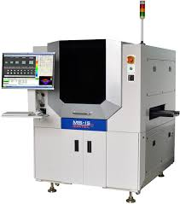
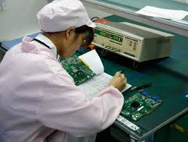
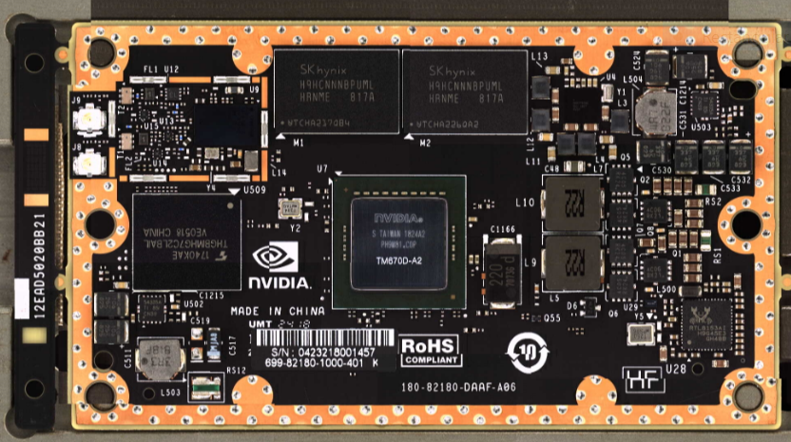
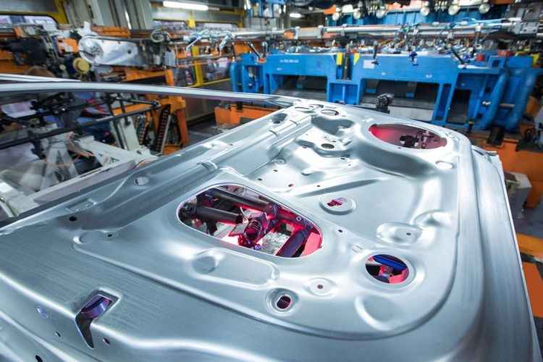

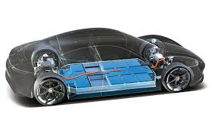
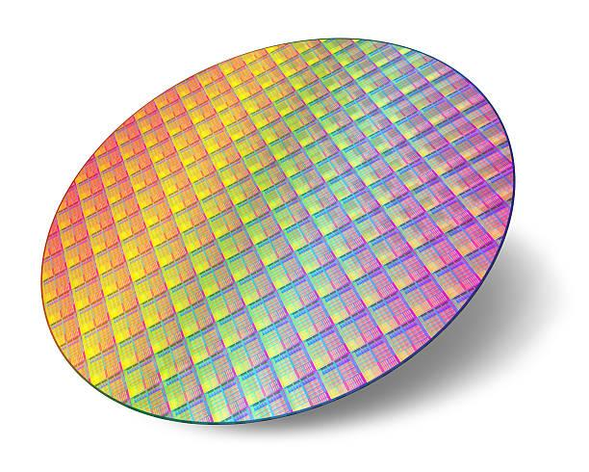

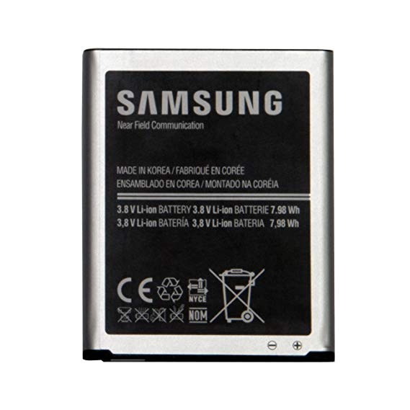
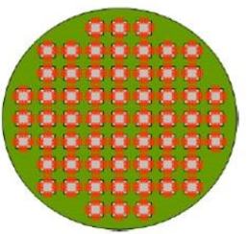
Manufacturing inspection use case
Industrial/Manufacturing Inspection Includes With and Without AOI
Automotive Manufacturing
PCB*
AOI* Check / Capture
Verify
by OP
Repair
Display panel
NG
Defect
True Positive
Battery Surface Defects
(Electric Car, Mobile Phone)
OK*
Not Defect*
Foundry/Wafer
False Positive
Delivery
Delivery
IC Packaging
Not Defect
Defect (Escape)
True Negative
False Negative
* Some Escapes Can Occur When the Optical Inspection Process Fails to Detect Defect
*PCB: Printed Circuit Board
*AOI: Automatic Optical Inspection

Slide 12
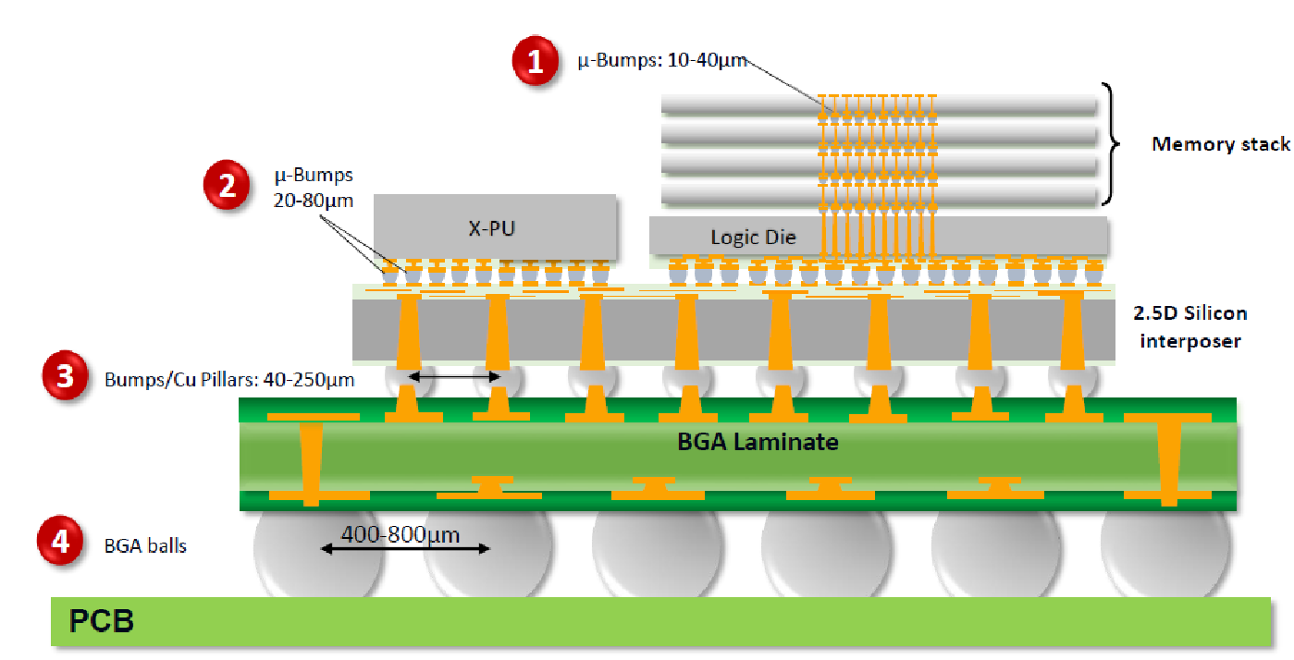
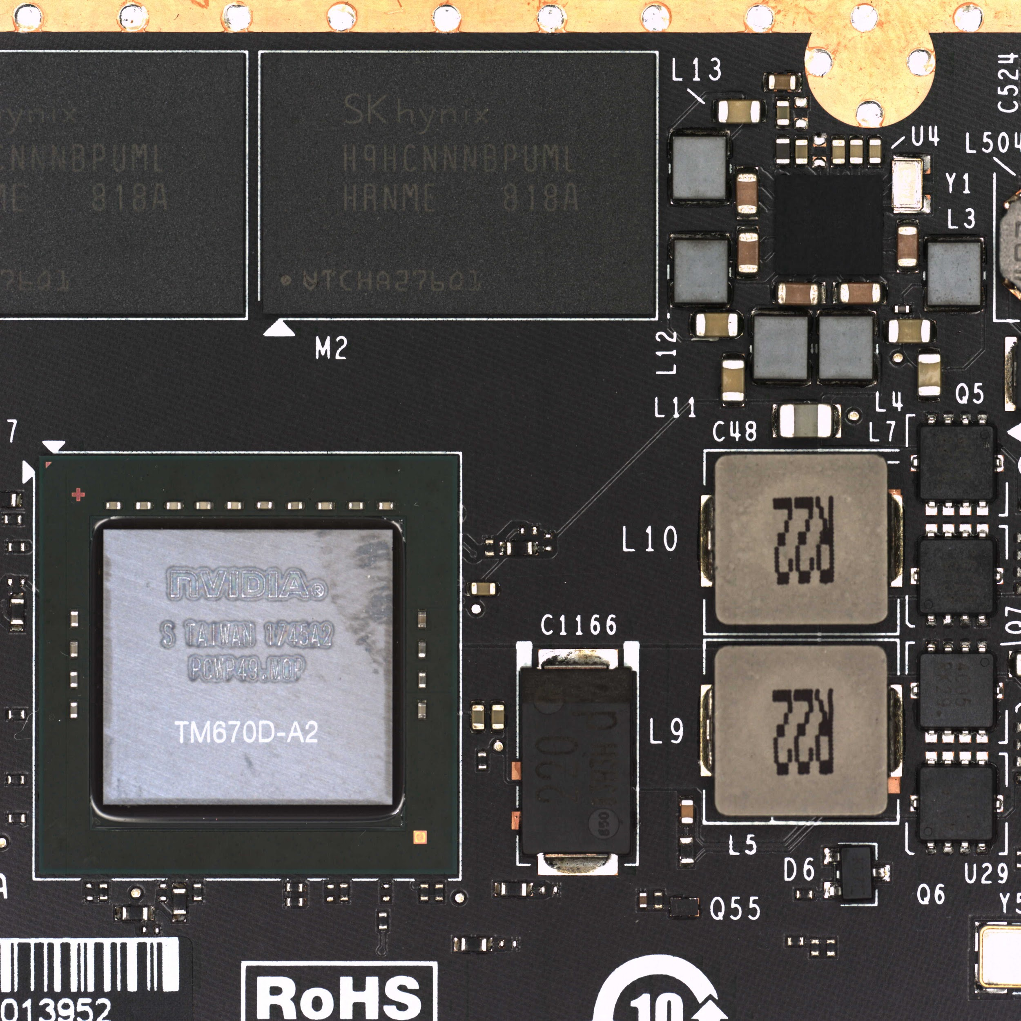
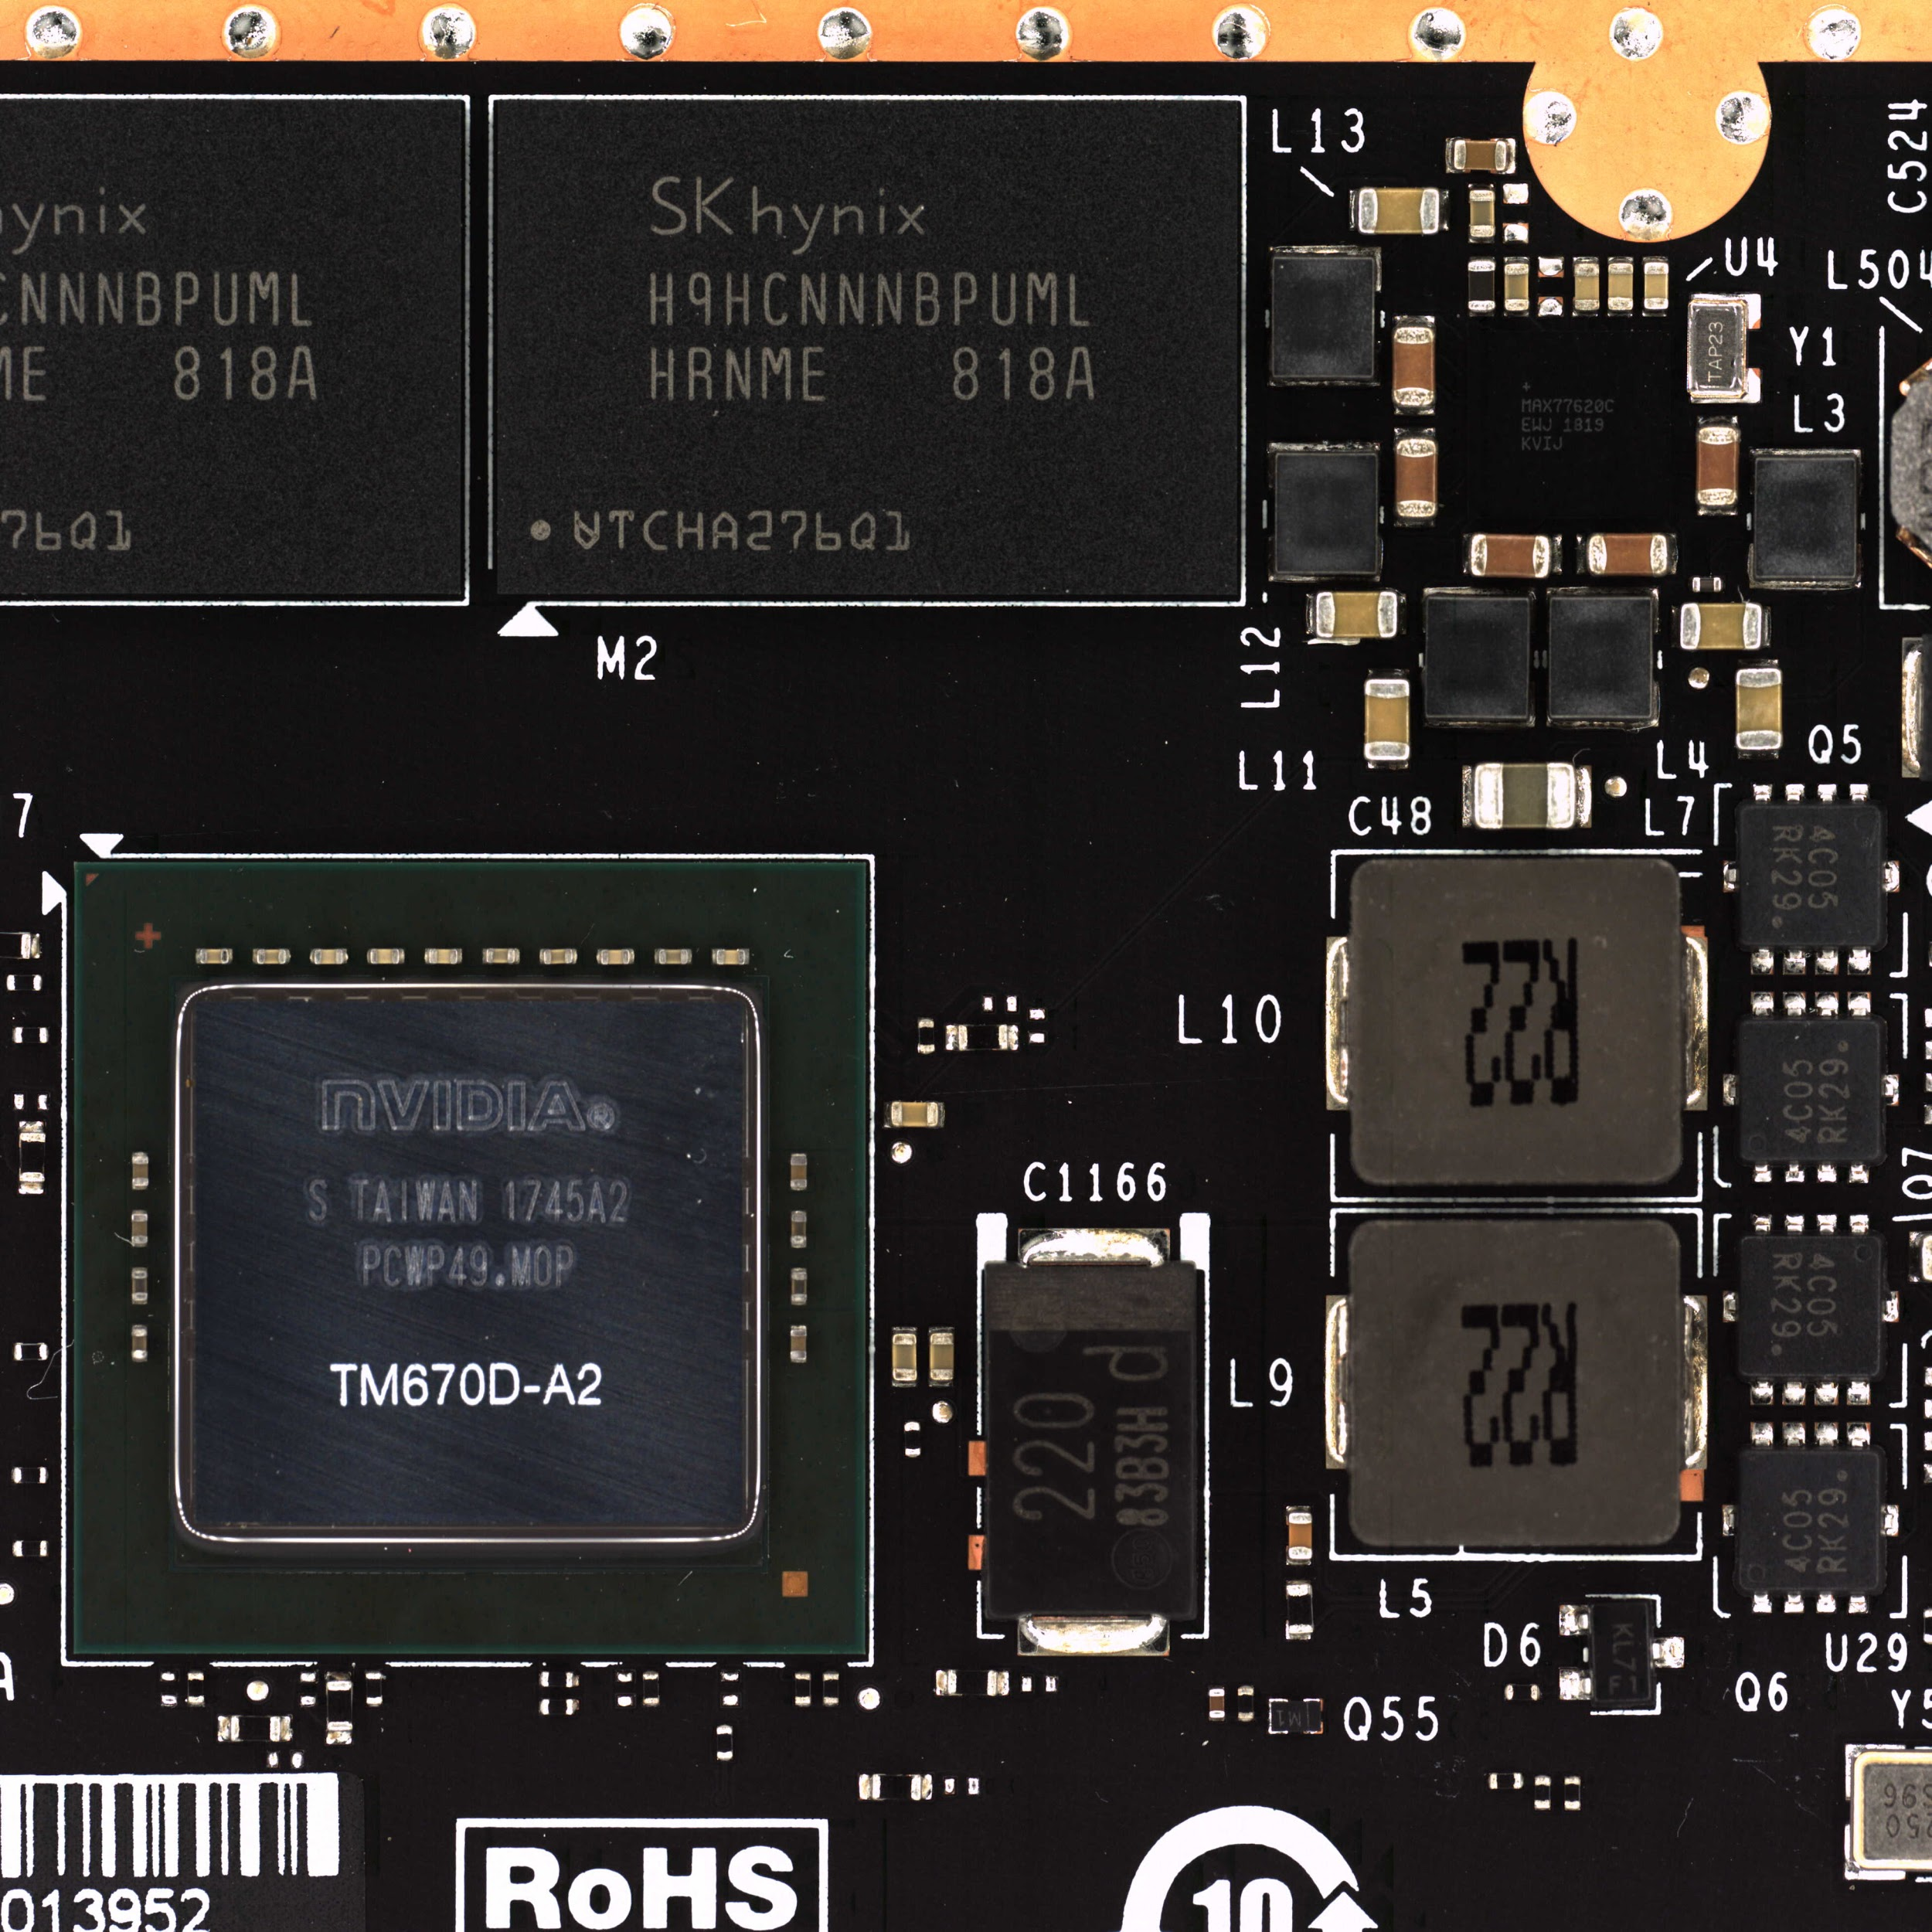
Challenges with PCBA Manufacturing
No 100% Inspection Possible for Solder Joints in Packaged Electronics Due to Design Complexity
Semiconductor/electronics verification cost is exponentially increasing as components become more complex
Current AOI machines, which use rules-based logic to identify defects, struggle due to vast number of criteria to test:
Quality of solder joins
Presence of each component
Position and orientation
Coplanarity
Presence of unwanted objects (solder spatter/ball)
Easily fooled (i.e. by the appearance of components with high variance)
Color Variation Can Fool Traditional AOI CV Algorithms

Slide 13
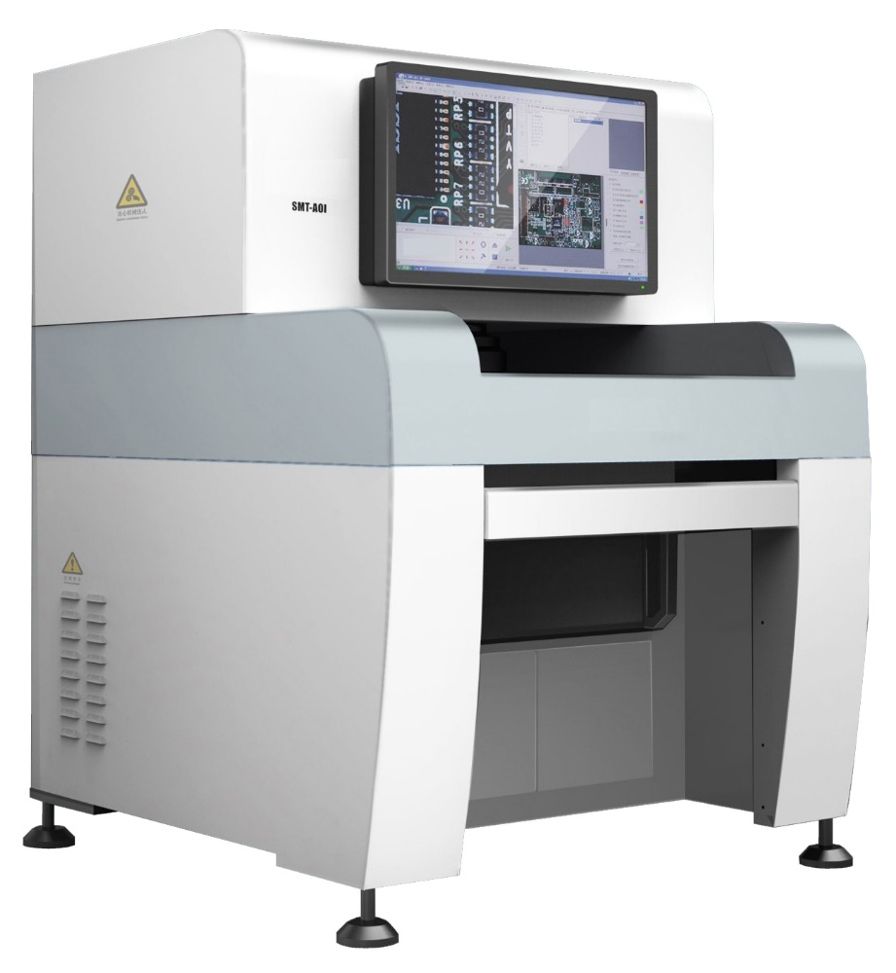
Challenges with AOI
Very High False Positive Rate & Non-Robust/Non-Reliable Detection Require Human Verification
AOI machine employs traditional CV algorithms
False positive rate can be up to 70%
Reduced throughput
Requires tedious manual inspection by human operator
Reliability problems
Increased cost
Requires frequent and costly manual algorithm tuning
???

Slide 14
DL-Based Solution Development workflow
Rapid Prototyping for Production
Scoping
Data Curation
Experimentation
Deployment
Model Development
Training
Inference
Train Set
Validation
Define the Problem
Gather Data
Data Curation
Model Evaluation
Deployment
Validation Set
Satisfied
Not Satisfied
Re-train
Monitoring
Data Drift Detected

Slide 15
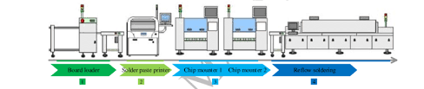
PBCA AOI Data and Decision flow
Only NG (Not Good) Data Are Saved on AOI Machine in Real Production
Store All Images in AOI Machine
AOI Test
Verify
by OP
Repair
NG
Defect
Printed Circuit Board Assembly Manufacturing Line
PCB board
True Positive
OK*
Not Defect*
False Positive
Images Not Stored
Delivery
Delivery
Not Defect
Defect (Escape)
True Negative
False Negative
We Will Use These Images to Build a Defect and Not-Defect Classification Model
* Some Escapes Can Occur When the Optical Inspection Process Fails to Detect Defect

Slide 16
Data Directory Structure
AOI_DL_data_0811
0423318023393
DefectInfo.html
AOI_DL_data_0820
0423318023715
defect.xml
AOI_DL_data_0826
0423318024105
DX_XXX.jpg
AOI_DL_data_0901
…
GX_XXX.jpg
…
0423418017357
...
AOI_DL_data_1209
AOI Defect list.xlsx
JudgementTime.txt
AOI Escape list.xlsx
reviewed.xml

Slide 17
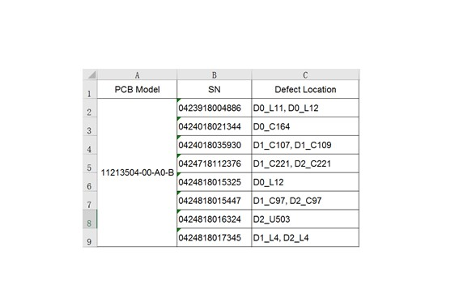
Manual verification by human inspectors
AOI Defect List.xslx Records True Positives

Slide 18
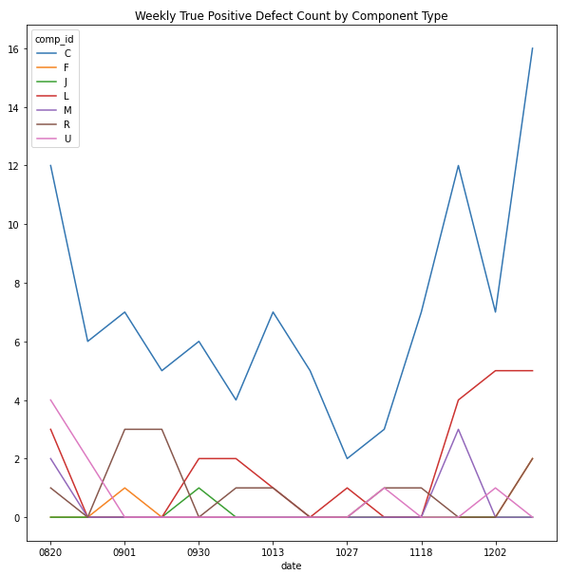
PCBA IC Components – True Defects Count
Observing Consistent Inflow of Capacitor Defects at the Factory

Slide 19
Sample aoi output from pbca board
AOI Images Already Localize IC Components (Object Detection Not Required)
VLSI board assembled by PCBA process
Sample capacitor images
from AOI machine

Slide 20
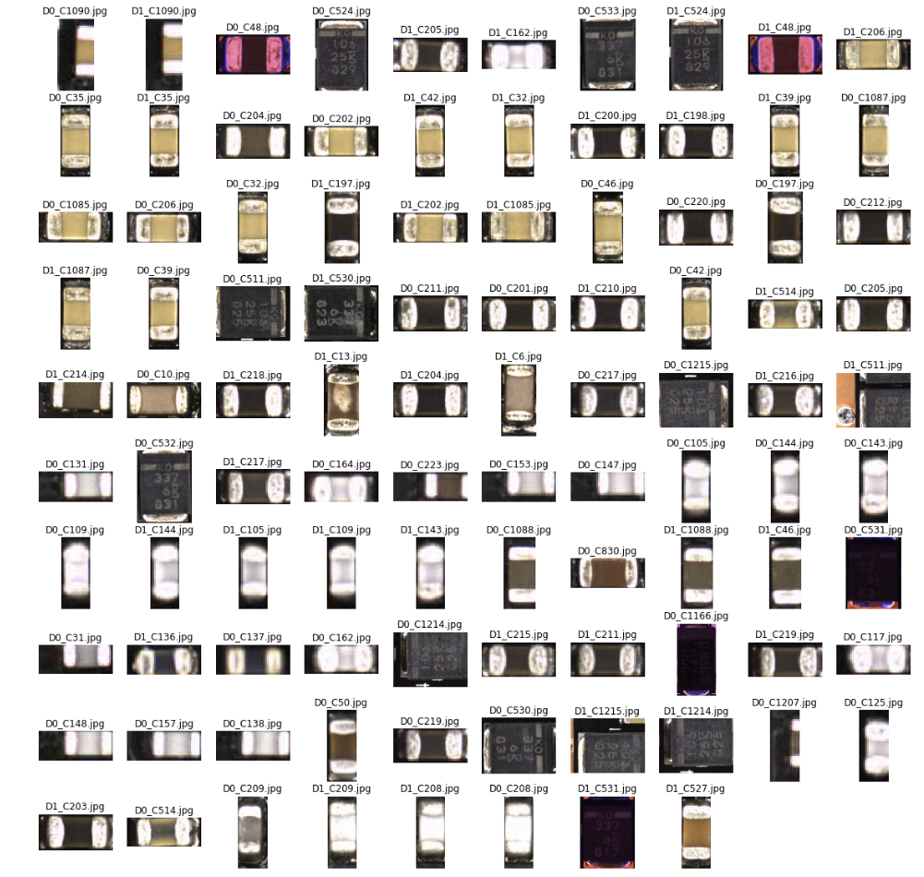
Traditional AOI yields high False positive rate
Traditional CV Algorithms in AOI Machines Have Limitations
Cannot differentiate:
Shifted Shot
Reflection Change
Illumination Change
Color Channel Change
Resulting in high (10 ~ 70%) false positive rate

Slide 21
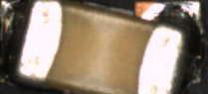
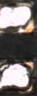
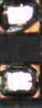
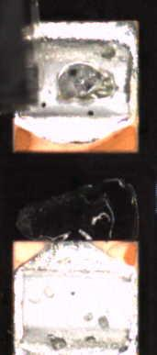
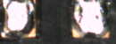
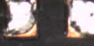

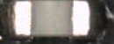
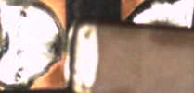
Examples of True positive Defected Capacitors
True Defects are Typically Due to Missing, Rotated, and Lifted Parts
Rotated
Rotated
Dis-colored
Lifted Package
Parts missing

Slide 22
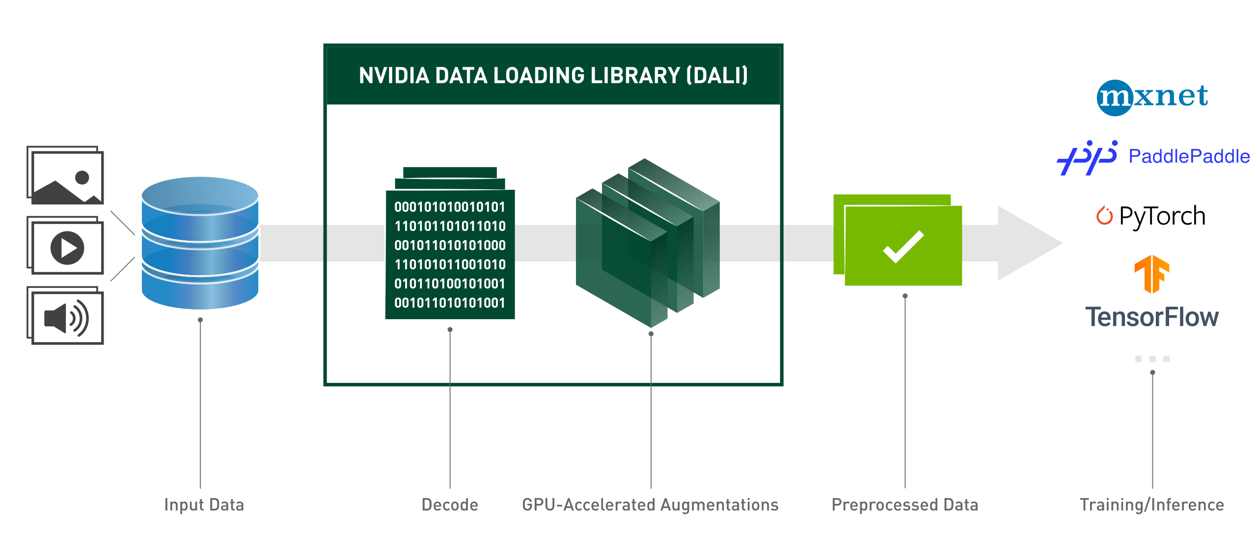
NVIDIA DALI - Data Loading Library
A Library for Data Loading and Pre-Processing to Accelerate Deep Learning Applications

Slide 23
End of lab 1

Slide 24
Lab 1 Summary
Discuss Automatic Optical Inspection, PCBA process, current challenges of AOI machines on high false positives
Analyze, manipulate, and visualize real dataset from GPU production line
Examine labeling of data obtained from AOI machine and curating dataset further
Scope into short-term DL automation problem

Slide 25
What’s next (Lab 2)
Apply transfer learning with ResNet-50 to train a custom classification model
Download pre-trained model/architecture from NGC
Apply augmentation technique to solve heavily imbalanced dataset
Fine-tune the model and setup evaluation metrics
Examine a confusion matrix and fine-tune results based on domain-expert tunable thresholding
Iterate “data curation – model training – error analysis” to further improve performance and reduce false positive rate

Slide 26
What’s Next (Lab 3)
Compile trained ResNet-50 model as TensorRT engine
Deploy TRT engine to Triton Inference Server
Send inference request to server
Compare the performance improvement using various inference configuration

